Slide 1
Jasmine Javascript BDD Testing

Slide 2
BDD – Behaviour Driven Testing
Create Scenarios for testing the Code
Understand Workflows and map them to the Code
Can be applied separately as a SPEC file for testing the Workflow
Adds details about Workflow that can be mapped to the Class/Code

Slide 3
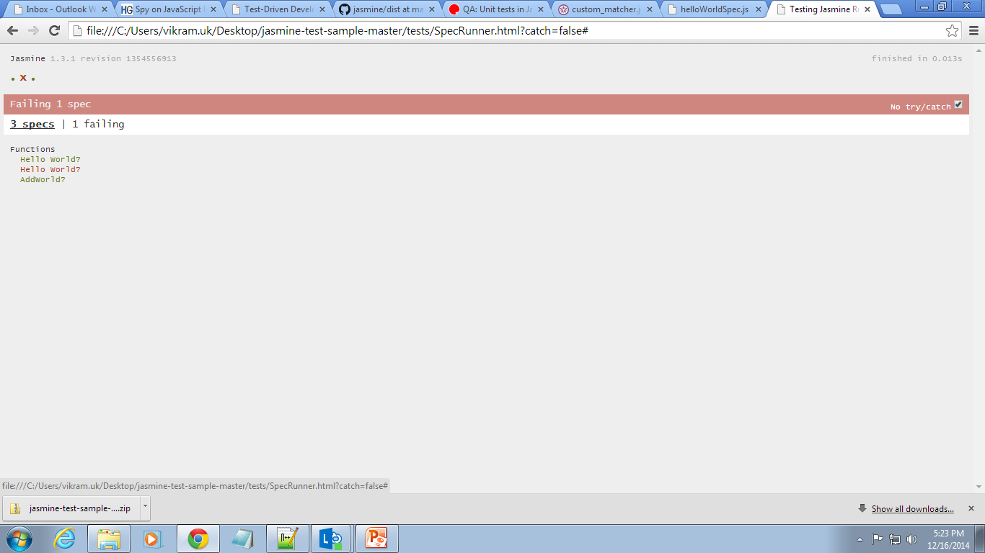
Testing using Spec Files
lib - library files for javascript
spec - script files for the .js functions
src – html files where the spec is tested

Slide 4
Custom Matchers for Spec
Reference
Specific matchers need to be created for matching the return value of the Function.

Slide 5
References
http://www.frontdojo.com/qa-unit-tests-in-javascript-with-jasmine/
http://jasmine.github.io/edge/custom_matcher.html
https://github.com/jasmine/jasmine/tree/master/dist

Slide 6
Thank You

